Slide 1
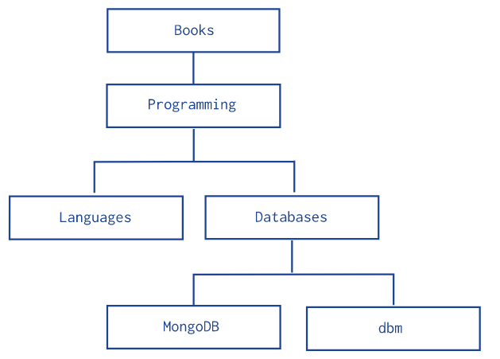
Model Tree Structures with Parent References
Data model that describes a tree-like structure in MongoDB documents by storing references to “parent” nodes in children nodes.
The Parent References pattern stores each tree node in a document; in addition to the tree node, the document stores the id of the node’s parent.
Hierarchy of Categories
Below example models the tree using Parent References, storing the reference to the parent category in the field parent
db.categories.insertMany( [
{ _id: "MongoDB", parent: "Databases" },
{ _id: "dbm", parent: "Databases" },
{ _id: "Databases", parent: "Programming" },
{ _id: "Languages", parent: "Programming" },
{ _id: "Programming", parent: "Books" },
{ _id: "Books", parent: null }
] )

Slide 2
Model Tree Structures with Parent References
db.categories.findOne( { _id: "MongoDB" } ).parent
db.categories.createIndex( { parent: 1 } )
db.categories.find( { parent: "Databases" } )

Slide 3
Data Modelling in MongoDB
https://docs.mongodb.com/manual/tutorial/model-embedded-one-to-one-relationships-between-documents/

